Slide 1
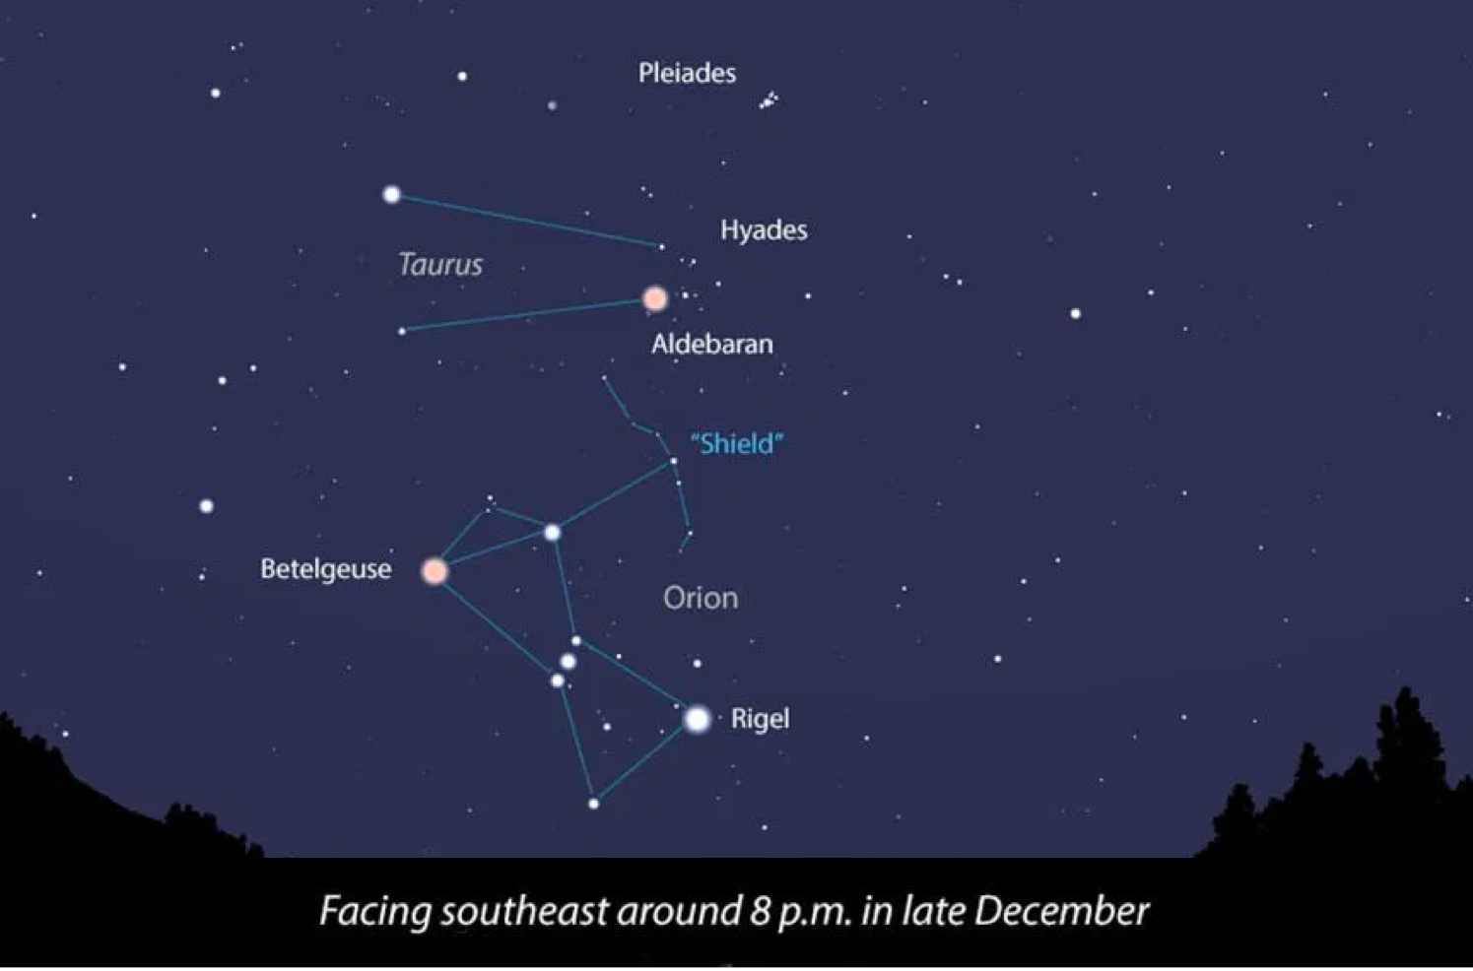
Intro to the Night Sky
09/02/22
TA: Jake Hanson

Slide 2
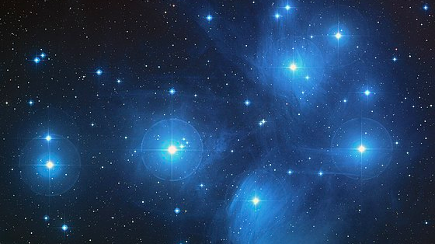
Tonight’s Lab
Summer vs Winter Constellations
How does this relate to the Zodiac?
Circumpolar Stars
Stellar Nomenclature and Magnitudes
Scintillation and the Color of Stars
Constellation Tour with Stellarium
Star Wheel and Star Charts
Assignments due next Wednesday:
Lab Script (50 pts)
Need star charts/wheels, and Stellarium web
Upload single pdf to canvas
Quiz (30 pts)
Motion of the Night Sky Online Prelab (20 pts)

Slide 3
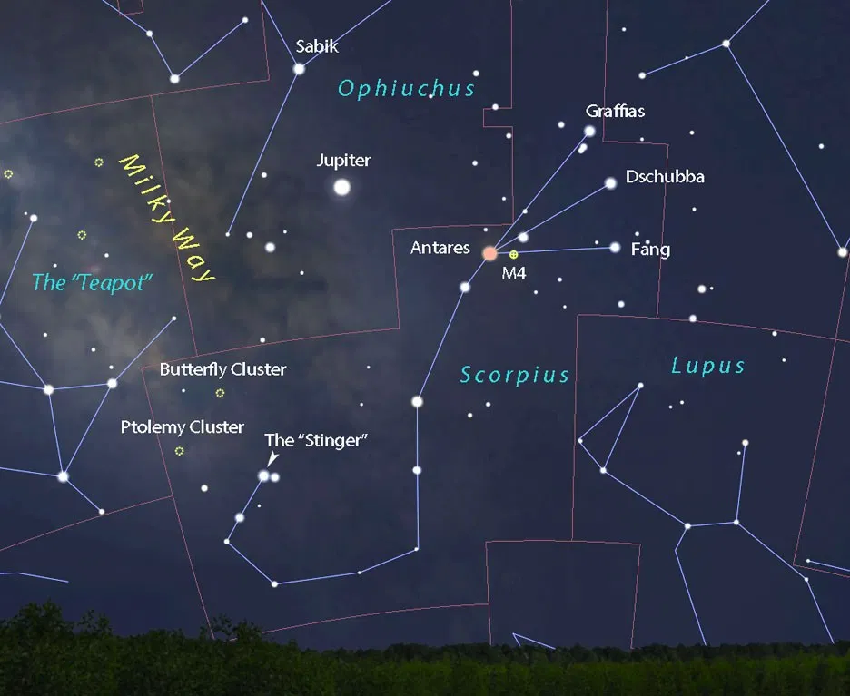
Winter
Summer

Slide 4
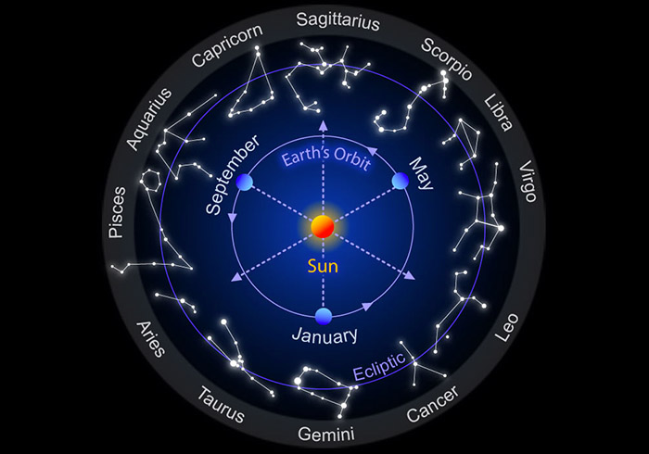
Zodiac
Signs
Early Summer constellation
Early Summer Horoscope

Slide 5
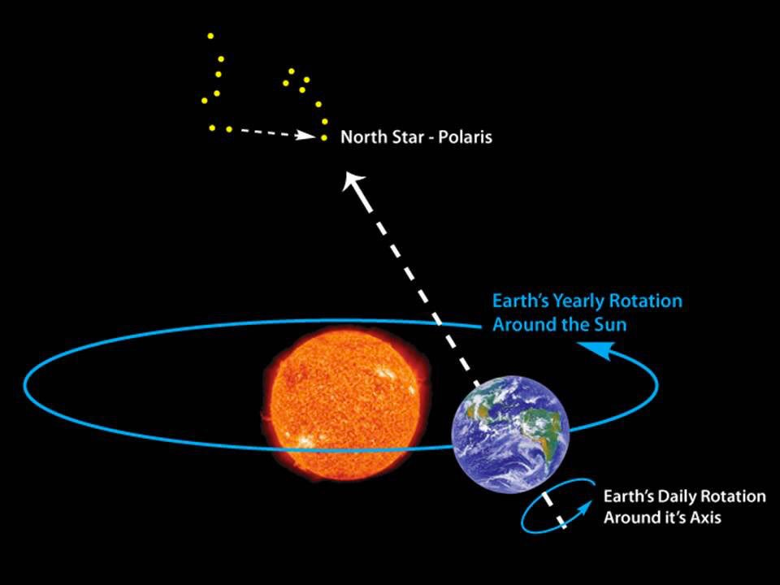
Circumpolar Stars/Constellations

Slide 6
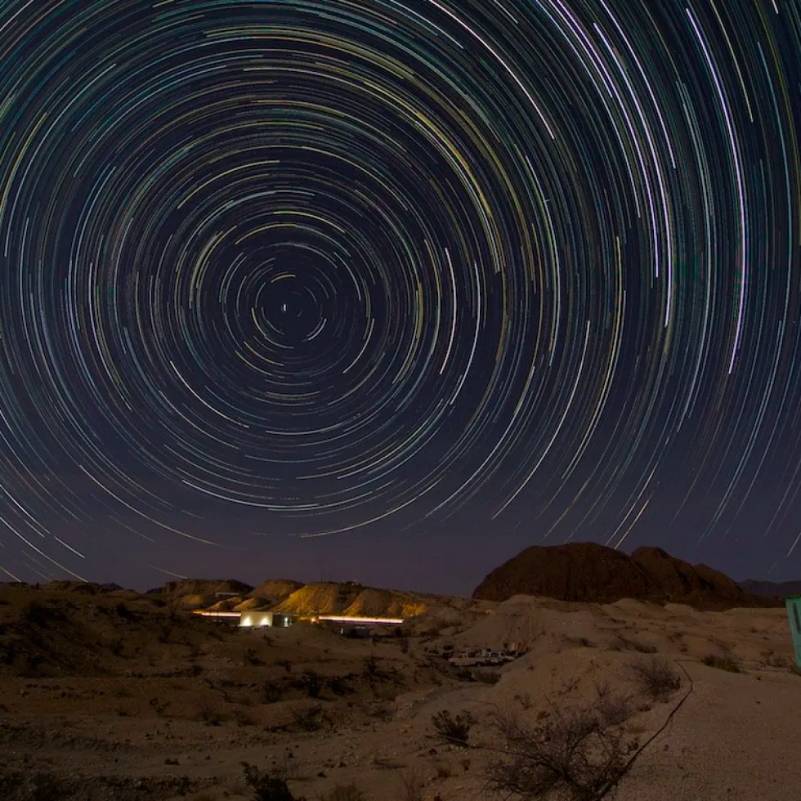
Circumpolar Constellations
A circumpolar constellation is a constellation that never sets below the horizon due to its apparent proximity to one of the celestial poles.

Slide 7
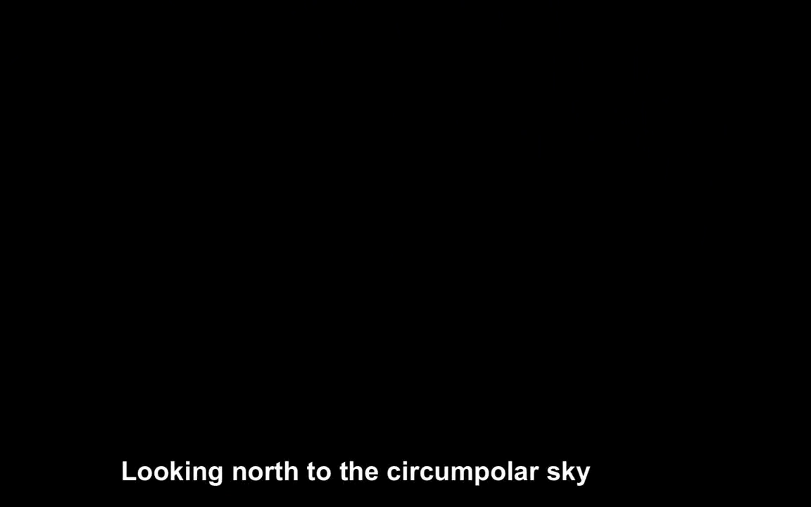
Circumpolar Stars (Video)

Slide 8
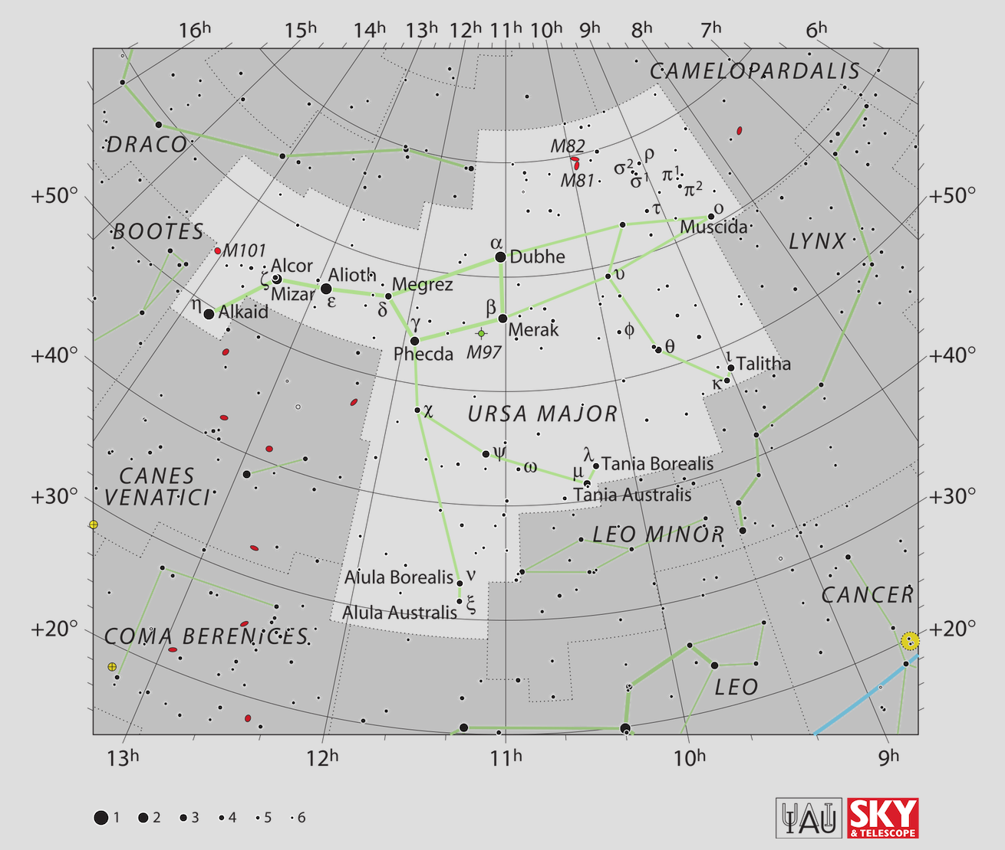

Stellar Nomenclature
Common Name | Constellation | Proper Name
Dubhe | Ursa Major
Merak | Ursa Major
Phecda | Ursa Major
Megrez | Ursa Major
Alioth | Ursa Major
Alcor/Mizar | Ursa Major

Slide 9
Stellar Magnitudes
The smaller the number the brighter the star
Size indicates brightness on a star wheel/chart
Some famous stars:
Sirius (alpha Canus Major) = -1.46
Arcturus (alpha Bootes) = -0.05
Vega (alpha Lyra) = 0.03
Capela (alpha Auriga)* = 0.08
Rigel (alpha Orion) = 0.13
Betelgeuse (beta Orion)** = 0.2-1.2
Recall, planets can be brighter than stars!
Venus = -4.14
Jupiter = -2.2
Saturn = 0.46
*Quadruple star system (two binary pairs)
** Variable star

Slide 10
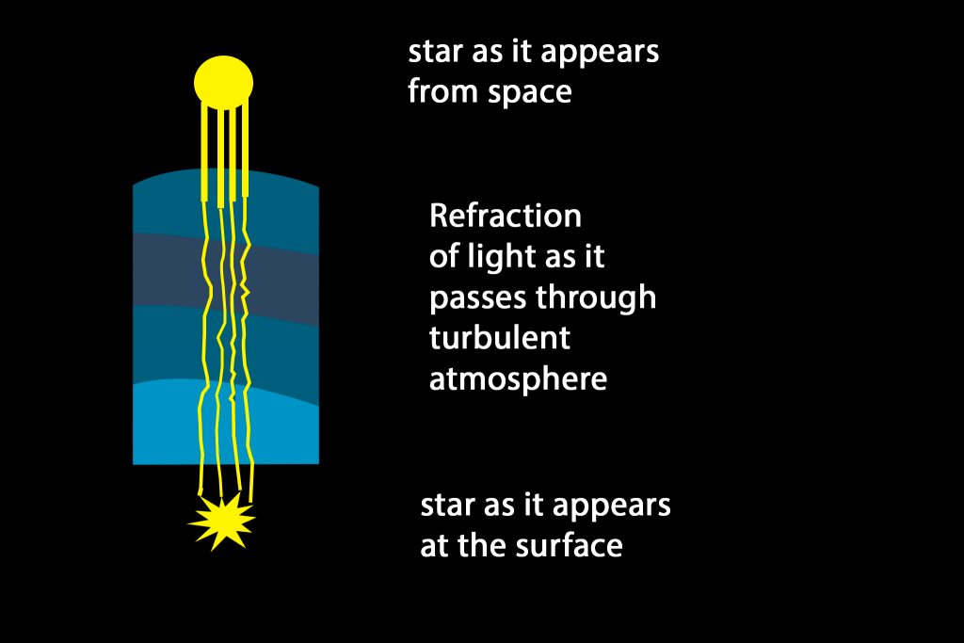
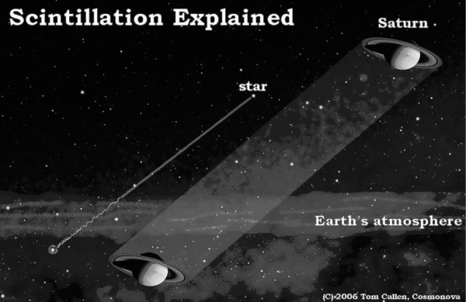
Stars twinkle, Planets Don’t

Slide 11
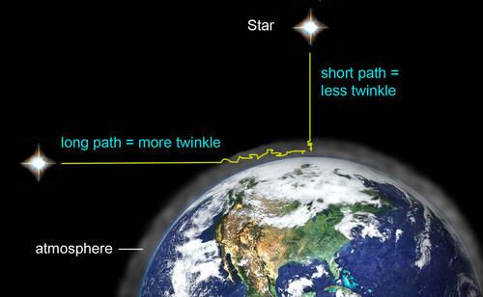
City lights and Stars Twinkle for the Same Reason (scintillation)

Slide 12
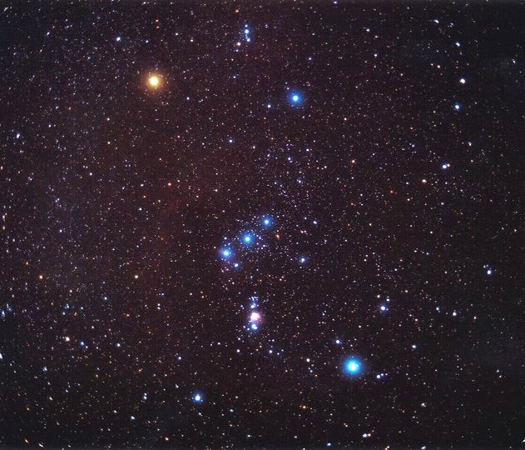
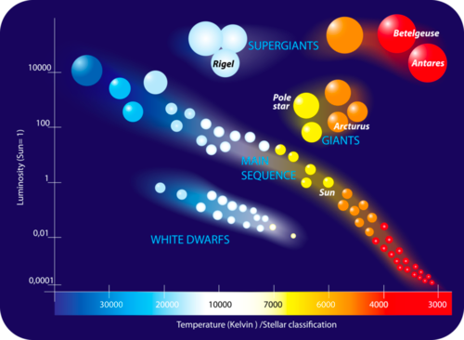
The Color of Stars
Betelgeuse
Bellatrix
Orion’s Belt
Rigel

Slide 13
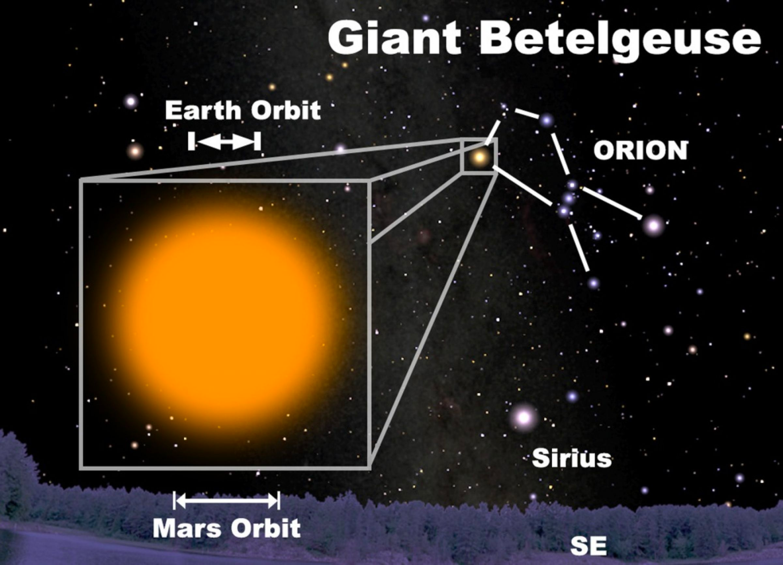
Betelgeuse
Red Supergiant
100,000x less dense than air Red Supergiant

Slide 14
Stellarium Star Tour

Slide 15
How to use your Star Wheel/Stellarium

Slide 16
Your Assignments
Complete the lab script (50 pts)
Use your star wheel, star charts, and/or stellarium
Stellarium.org -> “Stellarium Web”
Upload to canvas (link on Home Page and in Assigments Tab)
Complete the Quiz (30 pts)
Available on Canvas
Complete Motion of the Night Sky Prelab (20 pts)
Available on Canvas

